Slide 1
Data Science
Session – 5
Date – 18th May, 2022

Slide 2
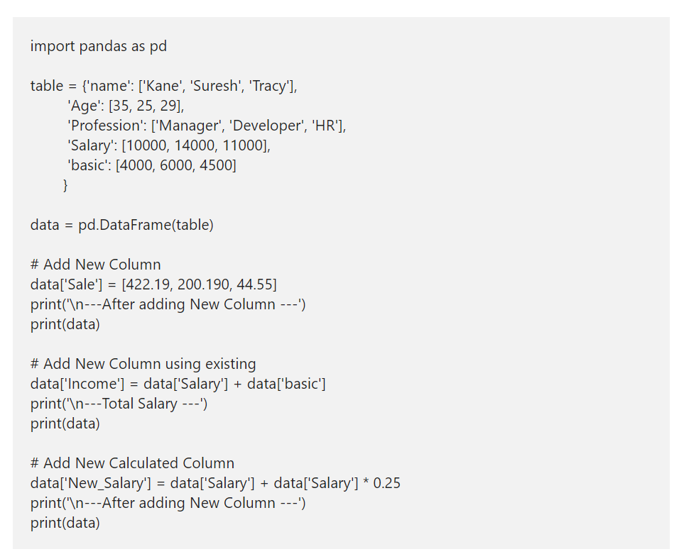
How to add a New Column to Pandas DataFrame?

Slide 3
Delete a Column from a DataFrame in Python
In Python, there are two ways to delete a column from a Pandas DataFrame. Either you can use del function or pop function. In this example, we are going to use both these function to delete columns from it.
Here, del(data[‘basic’]) deletes basic column (complete rows belong to basic column). x = data.pop(‘Age’) deletes or pops Age column, and we are printing that popped column as well. Next, we used the drop function to delete Sale column.

Slide 4
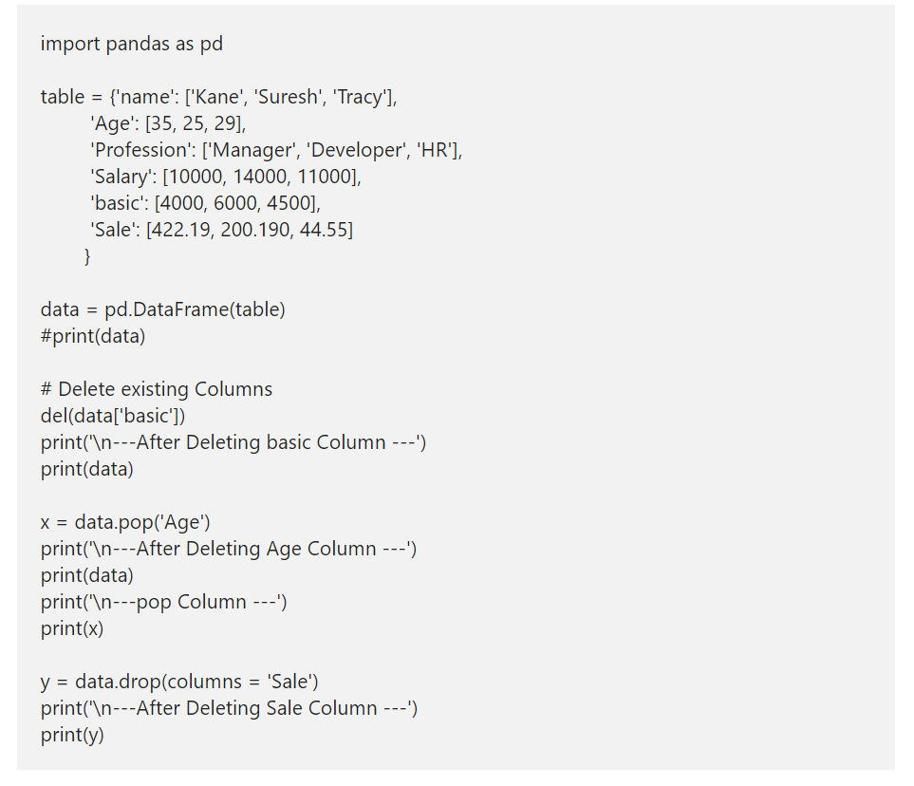
Delete a Column from a DataFrame in Python

Slide 5
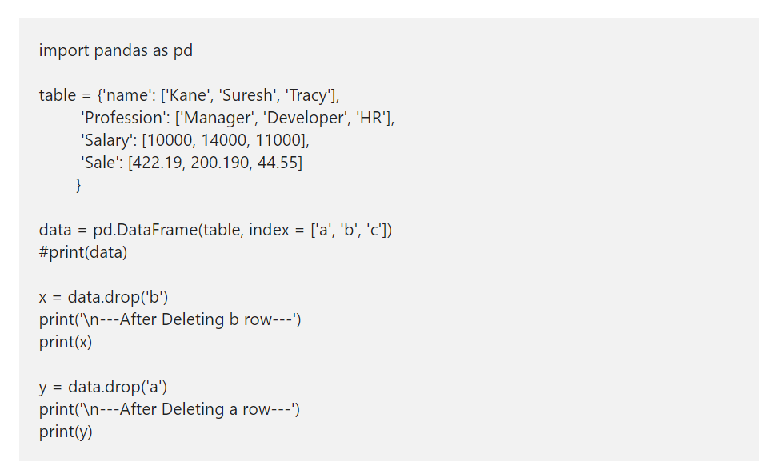
How to delete DataFrame Row in Python?

Slide 6
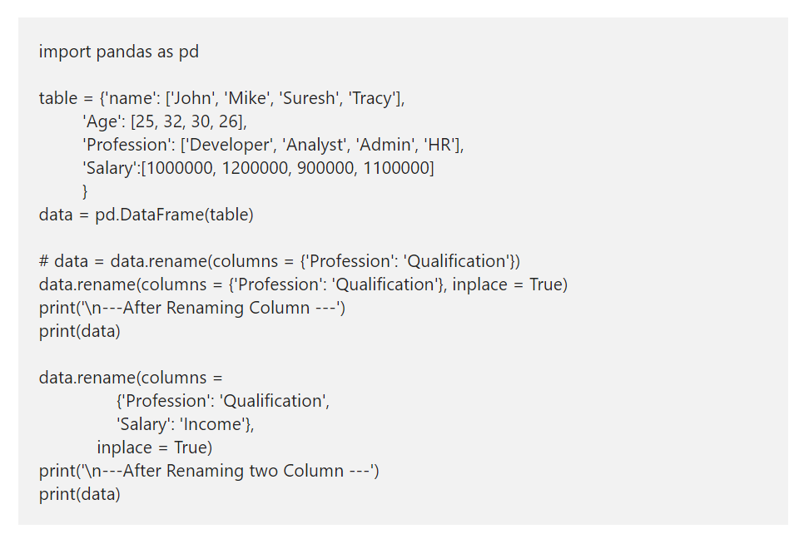
How to rename Pandas DataFrame Column?

Slide 7
Python pandas head and tail
If you are coming from R programming, you might be familiar with head and tail functions. The head function accepts integer value as an argument and returns Top or first given number of records.
For instance, head(5) returns Top 5 records. Similarly, Python DataFrame tail function returns bottom or last records. For example, tail(5) returns last 5 records or bottom 5 records.

Slide 8
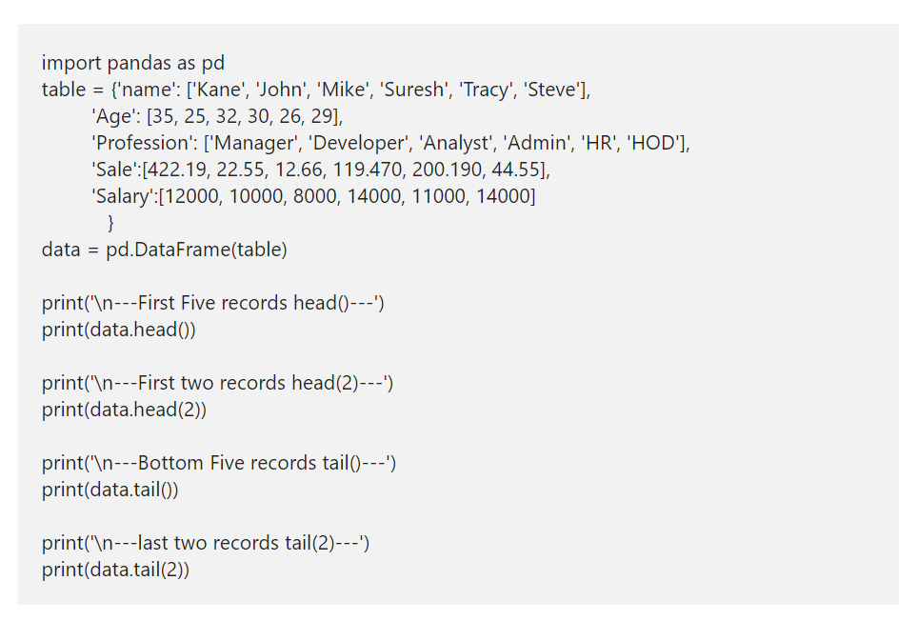
Python pandas head and tail

Slide 9
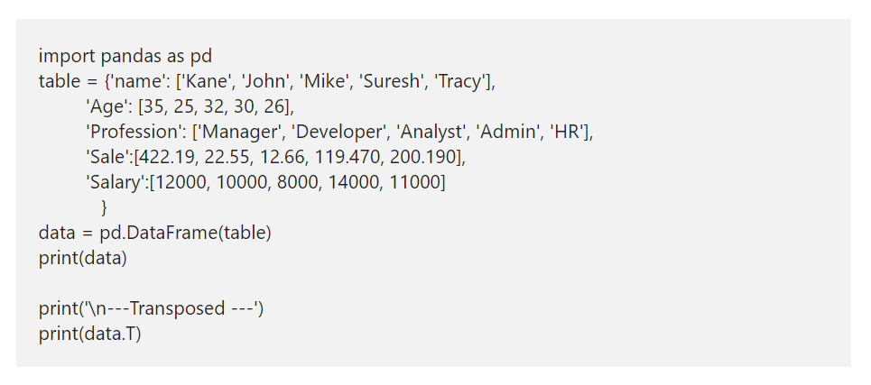
Transpose pandas DataFrame in Python
Transpose pandas DataFrame in Python

Slide 10
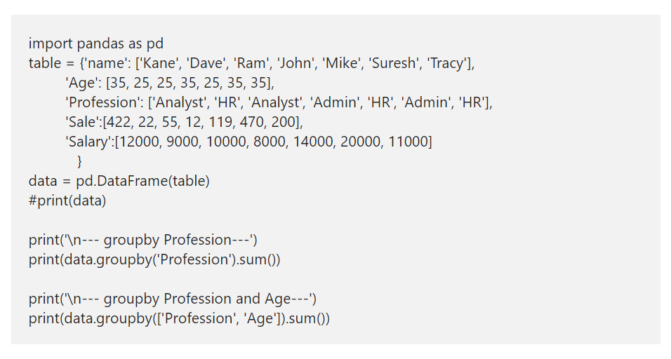
Python DataFrame groupby
A Python DataFrame groupby function is similar to Group By clause in Sql Server. I mean, you can use this Pandas groupby function to group data by some columns and find the aggregated results of the other columns. This is one of the important concept or function, while working with real-time data.

Slide 11
CHARTS

Slide 12
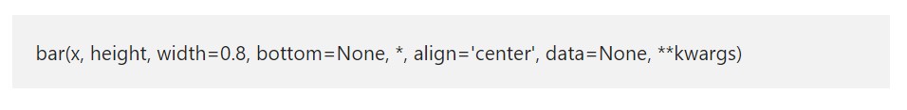
Python matplotlib Bar Chart
A Python Bar chart, Plot, or Graph in the matplotlib library is a chart that represents the categorical data in a rectangular format. By seeing those bars, one can understand which product is performing good or bad. It means the longer the bar, the better the product is performing. In Python, you can create both horizontal and vertical bar charts using this matplotlib library and pyplot.
The Python matplotlib pyplot has a bar function, which helps us to create this chart or plot from the given X values, height, and width. The basic syntax of the Python matplotlib bar chart is as shown below.

Slide 13
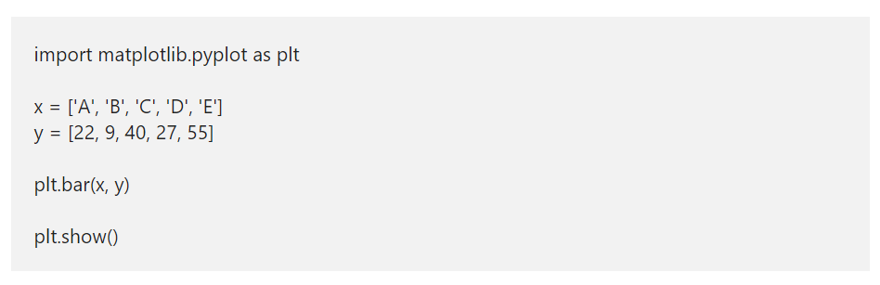
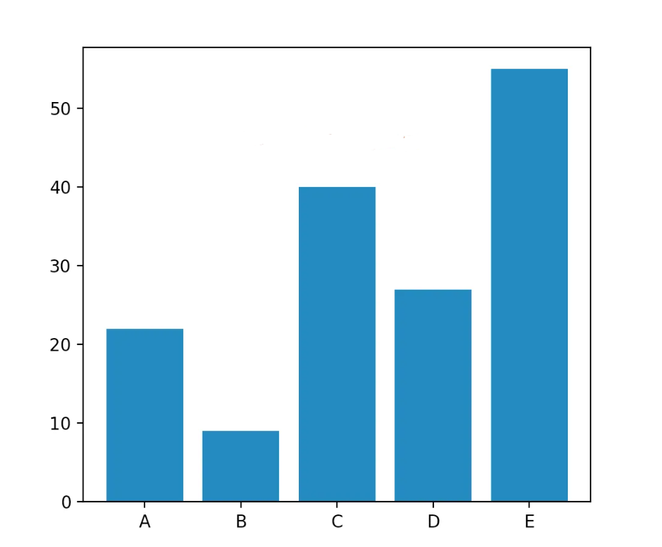
Create a Basic matplotlib bar chart in Python

Slide 14
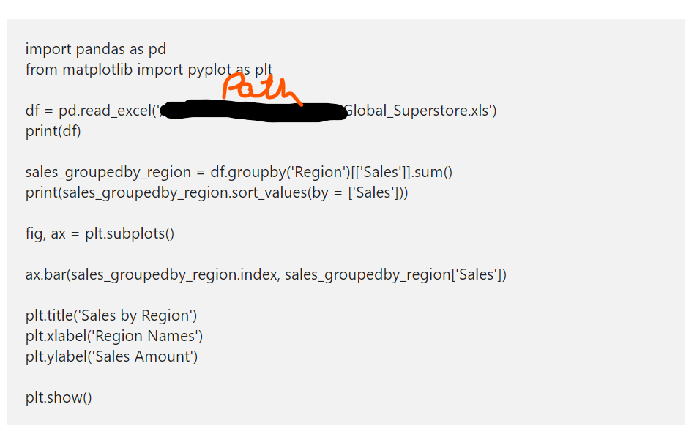
Python matplotlib Bar chart from CSV file

Slide 15
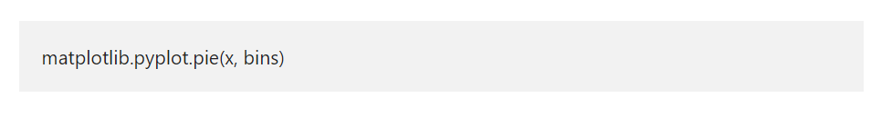
Python matplotlib Histogram
The Python matplotlib histogram looks similar to the pyplot bar chart. However, the data will equally distribute into bins. Each bin represents data intervals, and the matplotlib histogram shows the comparison of the frequency of numeric data against the bins.
In Python, you can use the Matplotlib library to plot histogram with the help of pyplot hist function. The hist syntax to draw matplotlib pyplot histogram in Python is

Slide 16
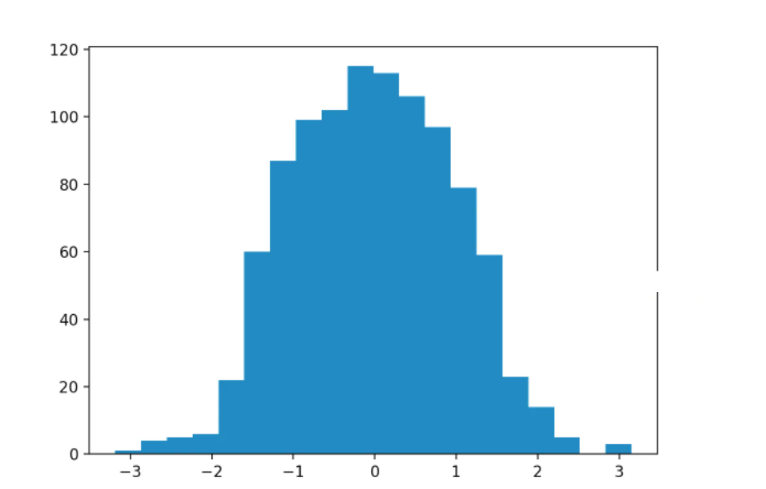
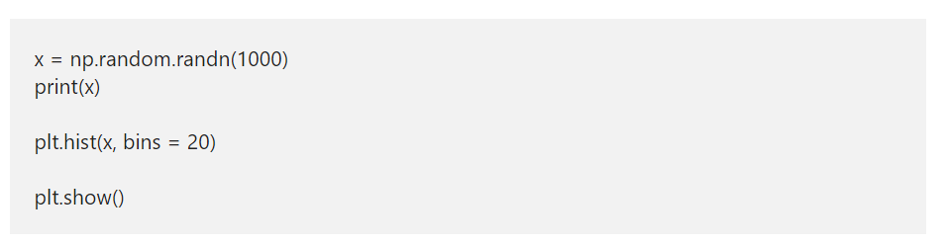
Simple matplotlib Histogram Example
Here, we used this argument number explicitly by assigning 20 to it. It means, below code will draw a hist of random numbers, and the data will equally distribute into 20 bins.

Slide 17
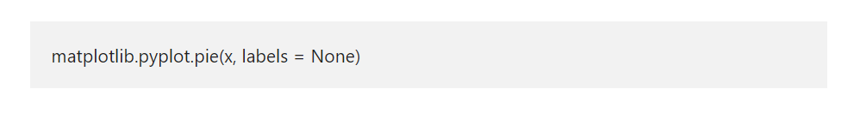
Python matplotlib Pie Chart
The Python matplotlib pie chart displays the series of data in slices or wedges, and each slice is the size of an item. In order to draw at the matplotlib chart in Python, you have to use the pyplot pie function. The syntax of this Python matplotlib pie function is

Slide 18
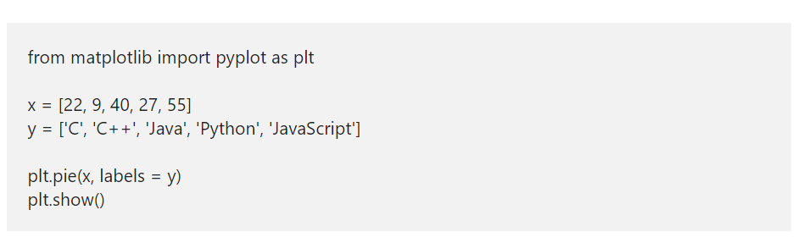
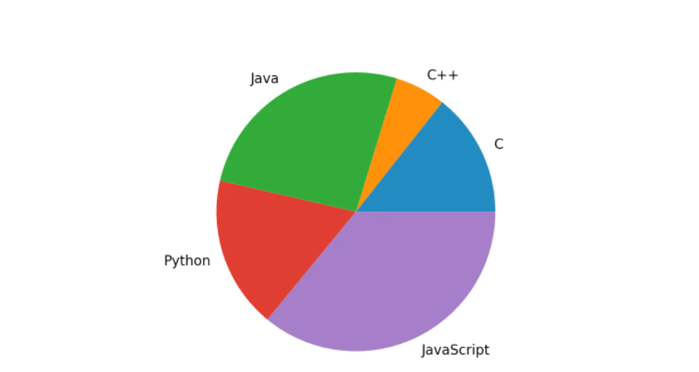
Python matplotlib Pie Chart Example

Slide 19
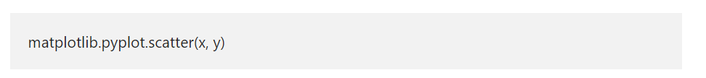
Python matplotlib Scatter Plot
The Python matplotlib scatter plot is a two dimensional graphical representation of the data. A Python scatter plot is useful to display the correlation between two numerical data values or two sets of data. In general, we use this Python matplotlib scatter plot to analyze the relationship between two numerical data points by drawing a regression line.
The matplotlib pyplot module has a function, which will draw or generate a scatter plot in Python. The basic syntax to draw matplotlib pyplot scatter plot is
x: list of arguments that represents the X-axis.
y: List of arguments represents Y-Axis.

Slide 20
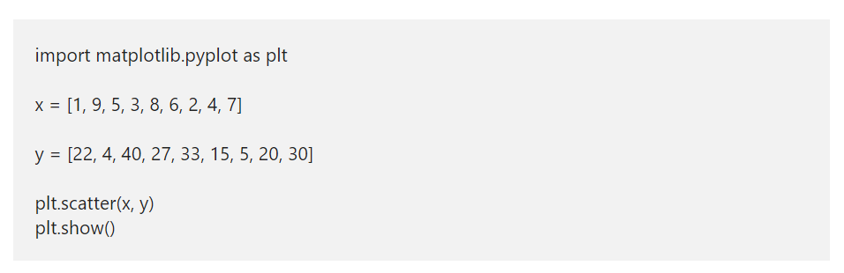
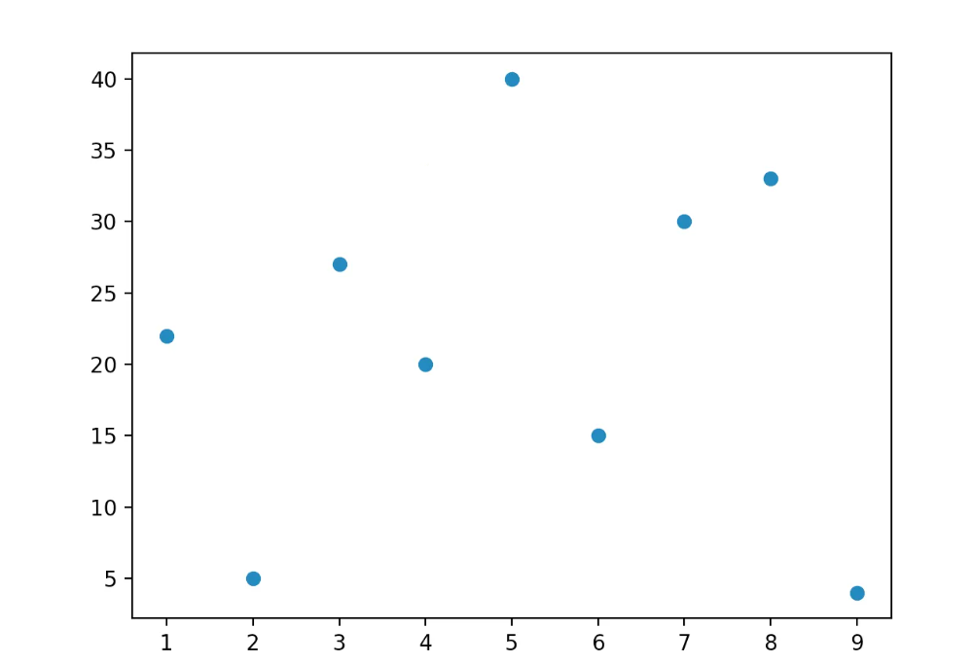
Python matplotlib Scatter Plot Examples

